Slide 1
Spreadsheet Project:
IT Ticket Analysis

Slide 2

Agenda
Problem Statement
Data Description
Objective Key Metrics and Visualizations
Subjective Question for Insights

Slide 3
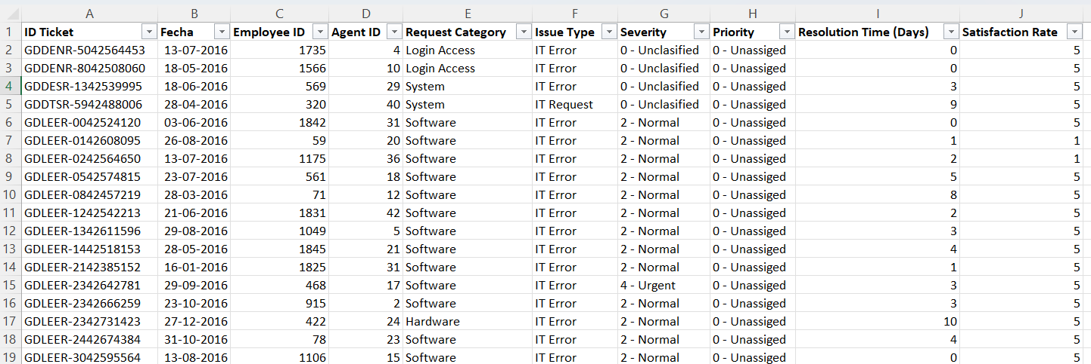
Problem Statement
The objective is to analyze the IT support ticket management system to understand the performance of IT agents, the efficiency of ticket resolution, and the satisfaction levels of employees. The analysis aims to identify high and low performers among IT agents, assess the overall effectiveness of the team, and pinpoint areas for improvement in the ticket resolution process. The ultimate goal is to make informed staffing decisions, including hiring, firing, and training, to enhance overall service quality and team performance.

Slide 4
The image above displays details about IT Ticket Information, including:
Tickets Sheet: Contains information about IT support tickets.
ID: Unique identifier for the ticket.
Ticket Fecha: Date of the ticket.
Employee ID: ID of the employee who raised the ticket.
Agent ID: ID of the agent assigned to the ticket.
Request Category: Category of the request (e.g., Login Access, System, Software).
Issue Type: Type of issue (e.g., IT Error, IT Request).
Severity: Severity of the issue.
Priority: Priority level of the issue.
Resolution Time (Days): Time taken to resolve the ticket.
Satisfaction Rate: Satisfaction rate provided by the employee (1-5 scale).
IT Agents: Contains information about IT agents.
Agent ID: Unique identifier for the agent.
Full Name: Full name of the agent.
Email: Email address of the agent.
Year of Birth: Year the agent was born.
Month of Birth: Month the agent was born.
Day of Birth: Day the agent was born.

Slide 5
Tickets volume over the years
Number of tickets raised are increasing per year on average of 58 percent per year.
There was 35.3% increase in tickets from 2019 to 2020.

Slide 6
Ticket distribution by Resolution time
Maximum tickets raised are in system category with login access having second highest number of tickets.

Slide 7
Ticket distribution by satisfaction rate
Maximum tickets raised are in system category with login access having second highest number of tickets.

Slide 8
Category wise ticket distribution
Maximum tickets raised are in system category with login access having second highest number of tickets.

Slide 9
Priority wise ticket distribution
Maximum tickets raised are in system category with login access having second highest number of tickets.

Slide 10
Category wise ticket distribution
Maximum tickets raised are in system category with login access having second highest number of tickets.

Slide 11
Average resolution time per category
Hardware and system related issued have higher resolution time compared to other categories.
Login access category has least resolution time of 0.3 days on average.

Slide 12
Average satisfaction rate per category
Login access category has the least average satisfaction rate of 4.09.

Slide 13
Average satisfaction rate age group wise
Agents younger than 50 years have low satisfaction rate with agents between 40 & 50 have the least satisfaction rate.

Slide 14
Average resolution time age group wise
Agents younger than 50 years have longer resolution time with agents between 30 & 40 have the longest resolution time.

Slide 15
Change in ticket volume yearly per category
System and Login Access category tickets have increased at higher rate from 2019 to 2020 compared to other categories.
Issues in system and Login Access category have increased at higher rate.

Slide 16
Insights
As per analysis, some agents have a much higher ratio than others, which could be an indicator of uneven skill distribution or experience levels within the team.
Agents 19, 22 28 have significantly low ratio. And nearly half of agents have ratio greater than 0.9.
Also, 40% of tickets raised are in system category. 37% of tickets are assigned with high priority which also indicates poor software performance.
Tickets raised in the 'System' category saw the highest increase in volume from 2019 to 2020. System category also has the 2nd highest average resolution time of 6.62 days.
Recommendations
It recommended to spend resources on upgrading ticket management software. Upgrading ticket management software may reduce number of tickets in system category or high alert tickets. This will in turn reduce work load on agents.
Company can also conduct internal training programs where high performing agents can help low performing agents with ticket resolution.

Slide 17
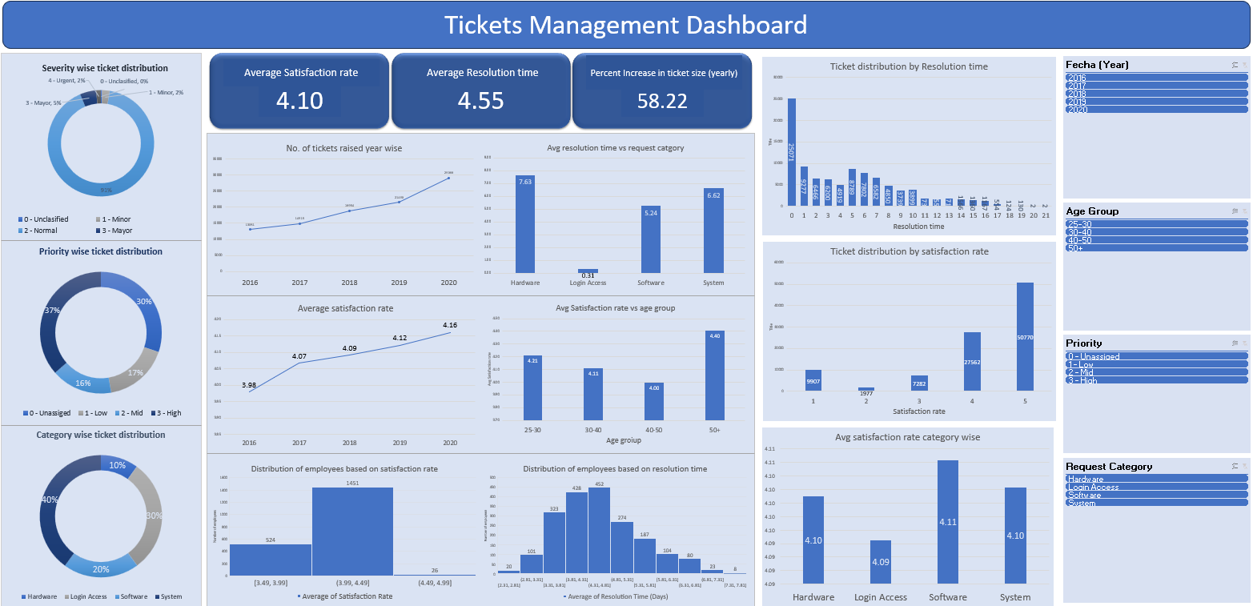
Dashboard

Slide 18


